Slide 1

MonkeyNet: A robust deep convolutional neural network for monkeypox disease detection and classification
Intelligent Network and Collaborative Computing Research Group
Name: Sohaib Asif 宋海泊
Student ID: 204708012
Advisor: Professor Ming Zhao
& Tang Fengxiao

Slide 2
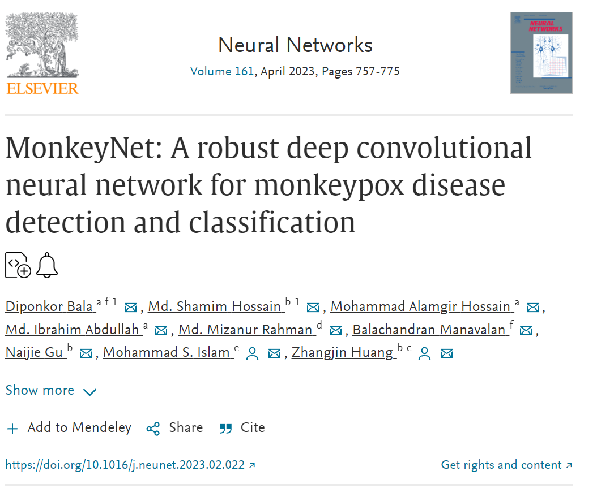

CCF B

Slide 3
01
02
PPT模板下载：www.1ppt.com/moban/ 行业PPT模板：www.1ppt.com/hangye/
节日PPT模板：www.1ppt.com/jieri/ PPT素材下载：www.1ppt.com/sucai/
PPT背景图片：www.1ppt.com/beijing/ PPT图表下载：www.1ppt.com/tubiao/
优秀PPT下载：www.1ppt.com/xiazai/ PPT教程： www.1ppt.com/powerpoint/
Word教程： www.1ppt.com/word/ Excel教程：www.1ppt.com/excel/
资料下载：www.1ppt.com/ziliao/ PPT课件下载：www.1ppt.com/kejian/
范文下载：www.1ppt.com/fanwen/ 试卷下载：www.1ppt.com/shiti/
教案下载：www.1ppt.com/jiaoan/ PPT论坛：www.1ppt.cn
INTRODUCTION
DATA COLLECTION
CONTENTS
03
METHODOLOGY
04
RESULTS AND DISCUSSION

Slide 4
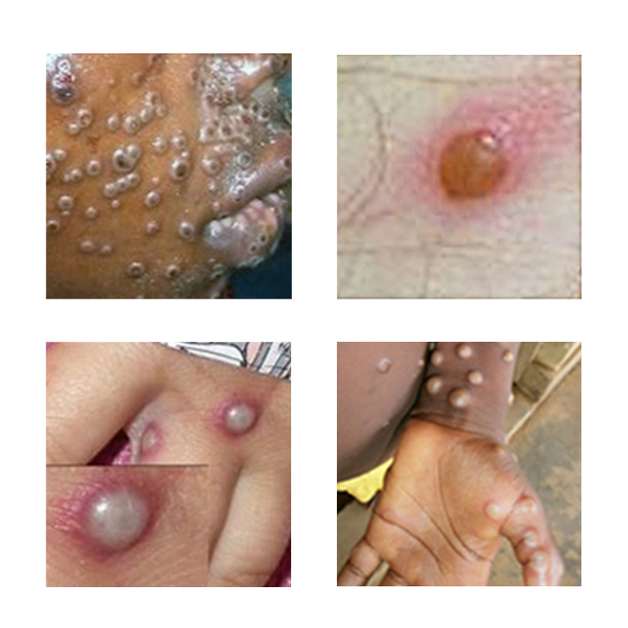
The very infrequent monkeypox disease is caused by a virus called the monkeypox virus.
At this time, there is no antiviral therapy that will cure us enough to treat monkeypox.
Now the researchers need to find an effective way to identify monkeypox disease and do the data collection and research trial.
There is a need in this field because there are so many cases of monkeypox and not enough testing kits.
INTRODUCTION
PPT模板下载：www.1ppt.com/moban/ 行业PPT模板：www.1ppt.com/hangye/
节日PPT模板：www.1ppt.com/jieri/ PPT素材下载：www.1ppt.com/sucai/
PPT背景图片：www.1ppt.com/beijing/ PPT图表下载：www.1ppt.com/tubiao/
优秀PPT下载：www.1ppt.com/xiazai/ PPT教程： www.1ppt.com/powerpoint/
Word教程： www.1ppt.com/word/ Excel教程：www.1ppt.com/excel/
资料下载：www.1ppt.com/ziliao/ PPT课件下载：www.1ppt.com/kejian/
范文下载：www.1ppt.com/fanwen/ 试卷下载：www.1ppt.com/shiti/
教案下载：www.1ppt.com/jiaoan/ PPT论坛：www.1ppt.cn
DATA
COLLECTION
METHODOLOGY
RESULTS AND DISCUSSION
1

Slide 5
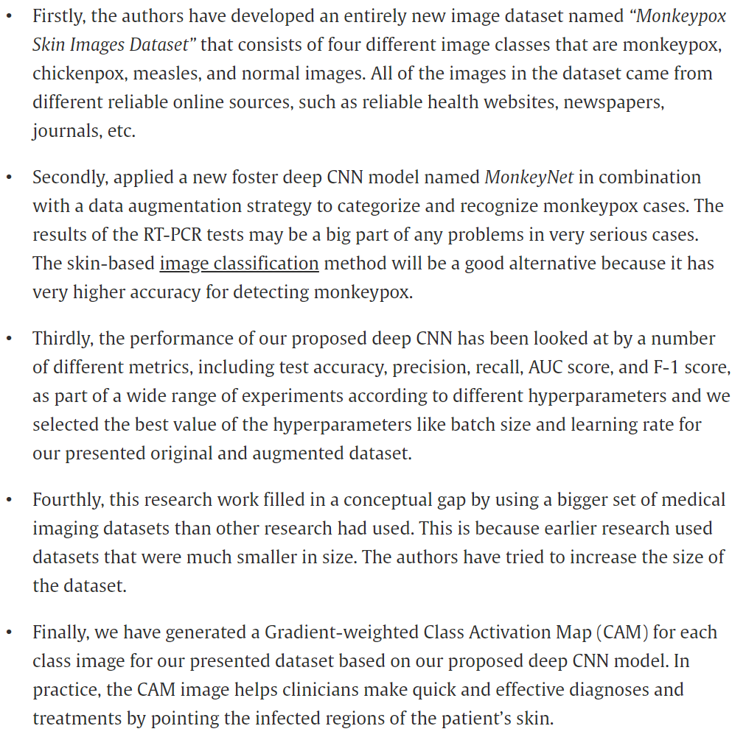
Motivation & Contributions
INTRODUCTION
PPT模板下载：www.1ppt.com/moban/ 行业PPT模板：www.1ppt.com/hangye/
节日PPT模板：www.1ppt.com/jieri/ PPT素材下载：www.1ppt.com/sucai/
PPT背景图片：www.1ppt.com/beijing/ PPT图表下载：www.1ppt.com/tubiao/
优秀PPT下载：www.1ppt.com/xiazai/ PPT教程： www.1ppt.com/powerpoint/
Word教程： www.1ppt.com/word/ Excel教程：www.1ppt.com/excel/
资料下载：www.1ppt.com/ziliao/ PPT课件下载：www.1ppt.com/kejian/
范文下载：www.1ppt.com/fanwen/ 试卷下载：www.1ppt.com/shiti/
教案下载：www.1ppt.com/jiaoan/ PPT论坛：www.1ppt.cn
DATA
COLLECTION
METHODOLOGY
RESULTS AND DISCUSSION
2

Slide 6
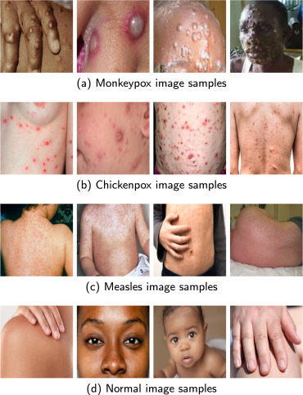
Data Collection
In order to accomplish this, the Google search engine is utilized for the purpose of gathering the images.
The authors have collected two types of images: one is monkeypox and the other type is non-monkeypox images. Additionally, the non-monkeypox type includes three types of images: chickenpox, measles, and normal image.
A total of 770 image have been collected,
the authors named the dataset
“MSID”, which is the short form of
“Monkeypox Skin Images Dataset”
INTRODUCTION
INTRODUCTION
PPT模板下载：www.1ppt.com/moban/ 行业PPT模板：www.1ppt.com/hangye/
节日PPT模板：www.1ppt.com/jieri/ PPT素材下载：www.1ppt.com/sucai/
PPT背景图片：www.1ppt.com/beijing/ PPT图表下载：www.1ppt.com/tubiao/
优秀PPT下载：www.1ppt.com/xiazai/ PPT教程： www.1ppt.com/powerpoint/
Word教程： www.1ppt.com/word/ Excel教程：www.1ppt.com/excel/
资料下载：www.1ppt.com/ziliao/ PPT课件下载：www.1ppt.com/kejian/
范文下载：www.1ppt.com/fanwen/ 试卷下载：www.1ppt.com/shiti/
教案下载：www.1ppt.com/jiaoan/ PPT论坛：www.1ppt.cn
PPT模板下载：www.1ppt.com/moban/ 行业PPT模板：www.1ppt.com/hangye/
节日PPT模板：www.1ppt.com/jieri/ PPT素材下载：www.1ppt.com/sucai/
PPT背景图片：www.1ppt.com/beijing/ PPT图表下载：www.1ppt.com/tubiao/
优秀PPT下载：www.1ppt.com/xiazai/ PPT教程： www.1ppt.com/powerpoint/
Word教程： www.1ppt.com/word/ Excel教程：www.1ppt.com/excel/
资料下载：www.1ppt.com/ziliao/ PPT课件下载：www.1ppt.com/kejian/
范文下载：www.1ppt.com/fanwen/ 试卷下载：www.1ppt.com/shiti/
教案下载：www.1ppt.com/jiaoan/ PPT论坛：www.1ppt.cn
RESEARCH CHALLENGES & LIMITATIONS
DATA
COLLECTION
RESEARCH IDEAS & OBJECTIVES
METHODOLOGY
RESEARCH ARRANGEMENT
RESULTS AND DISCUSSION
未来工作
3

Slide 7
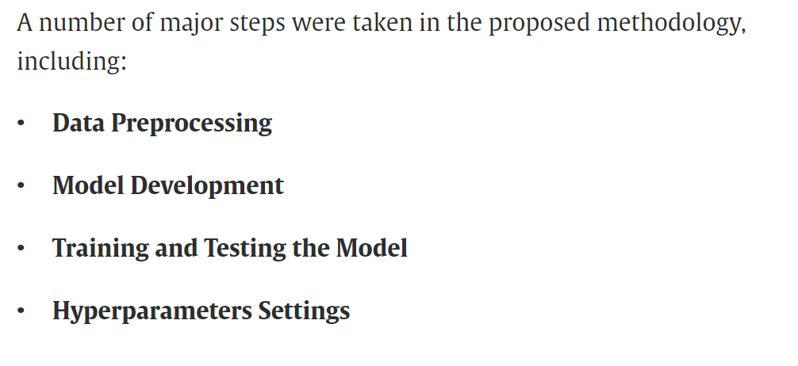
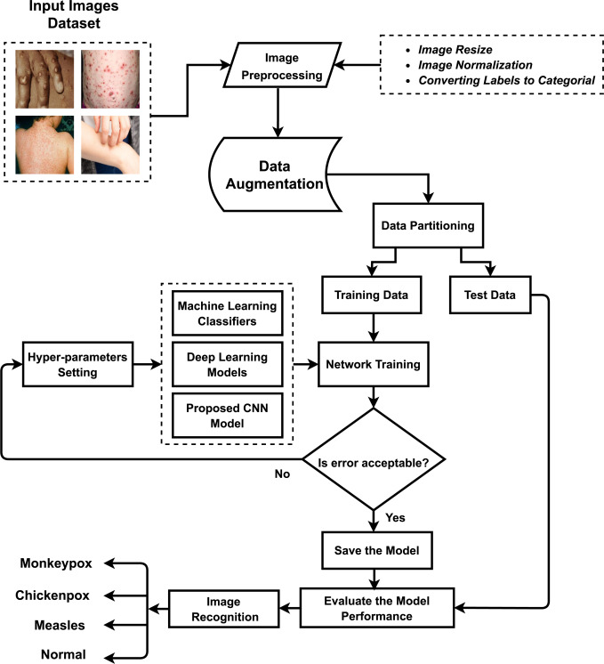
Proposed Methodology
INTRODUCTION
INTRODUCTION
PPT模板下载：www.1ppt.com/moban/ 行业PPT模板：www.1ppt.com/hangye/
节日PPT模板：www.1ppt.com/jieri/ PPT素材下载：www.1ppt.com/sucai/
PPT背景图片：www.1ppt.com/beijing/ PPT图表下载：www.1ppt.com/tubiao/
优秀PPT下载：www.1ppt.com/xiazai/ PPT教程： www.1ppt.com/powerpoint/
Word教程： www.1ppt.com/word/ Excel教程：www.1ppt.com/excel/
资料下载：www.1ppt.com/ziliao/ PPT课件下载：www.1ppt.com/kejian/
范文下载：www.1ppt.com/fanwen/ 试卷下载：www.1ppt.com/shiti/
教案下载：www.1ppt.com/jiaoan/ PPT论坛：www.1ppt.cn
PPT模板下载：www.1ppt.com/moban/ 行业PPT模板：www.1ppt.com/hangye/
节日PPT模板：www.1ppt.com/jieri/ PPT素材下载：www.1ppt.com/sucai/
PPT背景图片：www.1ppt.com/beijing/ PPT图表下载：www.1ppt.com/tubiao/
优秀PPT下载：www.1ppt.com/xiazai/ PPT教程： www.1ppt.com/powerpoint/
Word教程： www.1ppt.com/word/ Excel教程：www.1ppt.com/excel/
资料下载：www.1ppt.com/ziliao/ PPT课件下载：www.1ppt.com/kejian/
范文下载：www.1ppt.com/fanwen/ 试卷下载：www.1ppt.com/shiti/
教案下载：www.1ppt.com/jiaoan/ PPT论坛：www.1ppt.cn
RESEARCH CHALLENGES & LIMITATIONS
DATA
COLLECTION
RESEARCH IDEAS & OBJECTIVES
METHODOLOGY
RESEARCH ARRANGEMENT
RESULTS AND DISCUSSION
未来工作
4

Slide 8
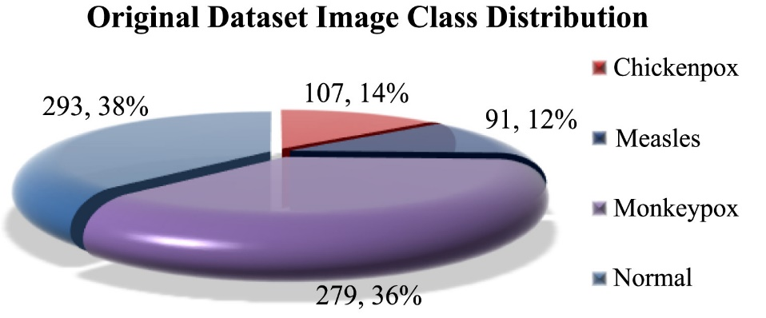
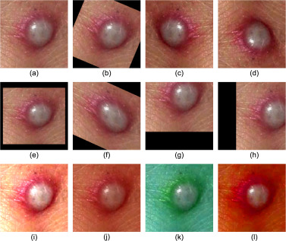

Proposed Methodology
Data preprocessing
The skin images in the dataset are transformed to RGB and then downsized to 224 × 224.
Data Splitting (80-20)
Augmentation
11 types of augmentation techniques are applied
INTRODUCTION
INTRODUCTION
PPT模板下载：www.1ppt.com/moban/ 行业PPT模板：www.1ppt.com/hangye/
节日PPT模板：www.1ppt.com/jieri/ PPT素材下载：www.1ppt.com/sucai/
PPT背景图片：www.1ppt.com/beijing/ PPT图表下载：www.1ppt.com/tubiao/
优秀PPT下载：www.1ppt.com/xiazai/ PPT教程： www.1ppt.com/powerpoint/
Word教程： www.1ppt.com/word/ Excel教程：www.1ppt.com/excel/
资料下载：www.1ppt.com/ziliao/ PPT课件下载：www.1ppt.com/kejian/
范文下载：www.1ppt.com/fanwen/ 试卷下载：www.1ppt.com/shiti/
教案下载：www.1ppt.com/jiaoan/ PPT论坛：www.1ppt.cn
PPT模板下载：www.1ppt.com/moban/ 行业PPT模板：www.1ppt.com/hangye/
节日PPT模板：www.1ppt.com/jieri/ PPT素材下载：www.1ppt.com/sucai/
PPT背景图片：www.1ppt.com/beijing/ PPT图表下载：www.1ppt.com/tubiao/
优秀PPT下载：www.1ppt.com/xiazai/ PPT教程： www.1ppt.com/powerpoint/
Word教程： www.1ppt.com/word/ Excel教程：www.1ppt.com/excel/
资料下载：www.1ppt.com/ziliao/ PPT课件下载：www.1ppt.com/kejian/
范文下载：www.1ppt.com/fanwen/ 试卷下载：www.1ppt.com/shiti/
教案下载：www.1ppt.com/jiaoan/ PPT论坛：www.1ppt.cn
RESEARCH CHALLENGES & LIMITATIONS
DATA
COLLECTION
RESEARCH IDEAS & OBJECTIVES
METHODOLOGY
RESEARCH ARRANGEMENT
RESULTS AND DISCUSSION
未来工作
5

Slide 9
Model Development
Machine learning classifiers
Five machine learning classifiers have used for the classification of monkeypox disease.
Logistic Regression, KNN, SVM, Random Forest, XGBoost
Deep learning models
Five deep learning models (VGG16, ResNet50, MobileNetV1, InceptionV3 & Xception)
Proposed model architectures
Pre-trained DenseNet-201 model as the foundation for network in order to create entire model and named proposed model as “MonkeyNet”
INTRODUCTION
INTRODUCTION
PPT模板下载：www.1ppt.com/moban/ 行业PPT模板：www.1ppt.com/hangye/
节日PPT模板：www.1ppt.com/jieri/ PPT素材下载：www.1ppt.com/sucai/
PPT背景图片：www.1ppt.com/beijing/ PPT图表下载：www.1ppt.com/tubiao/
优秀PPT下载：www.1ppt.com/xiazai/ PPT教程： www.1ppt.com/powerpoint/
Word教程： www.1ppt.com/word/ Excel教程：www.1ppt.com/excel/
资料下载：www.1ppt.com/ziliao/ PPT课件下载：www.1ppt.com/kejian/
范文下载：www.1ppt.com/fanwen/ 试卷下载：www.1ppt.com/shiti/
教案下载：www.1ppt.com/jiaoan/ PPT论坛：www.1ppt.cn
PPT模板下载：www.1ppt.com/moban/ 行业PPT模板：www.1ppt.com/hangye/
节日PPT模板：www.1ppt.com/jieri/ PPT素材下载：www.1ppt.com/sucai/
PPT背景图片：www.1ppt.com/beijing/ PPT图表下载：www.1ppt.com/tubiao/
优秀PPT下载：www.1ppt.com/xiazai/ PPT教程： www.1ppt.com/powerpoint/
Word教程： www.1ppt.com/word/ Excel教程：www.1ppt.com/excel/
资料下载：www.1ppt.com/ziliao/ PPT课件下载：www.1ppt.com/kejian/
范文下载：www.1ppt.com/fanwen/ 试卷下载：www.1ppt.com/shiti/
教案下载：www.1ppt.com/jiaoan/ PPT论坛：www.1ppt.cn
RESEARCH CHALLENGES & LIMITATIONS
DATA
COLLECTION
RESEARCH IDEAS & OBJECTIVES
METHODOLOGY
RESEARCH ARRANGEMENT
RESULTS AND DISCUSSION
未来工作
6

Slide 10
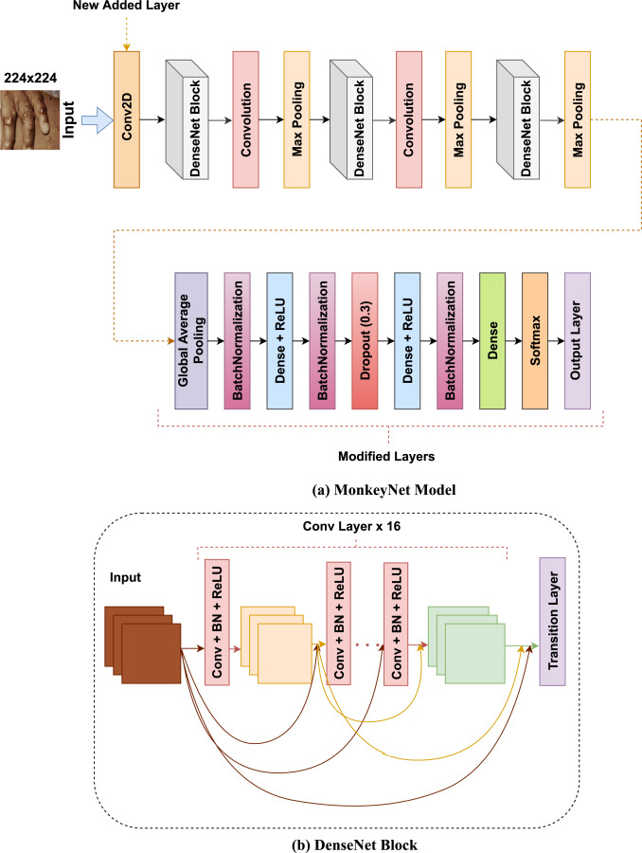
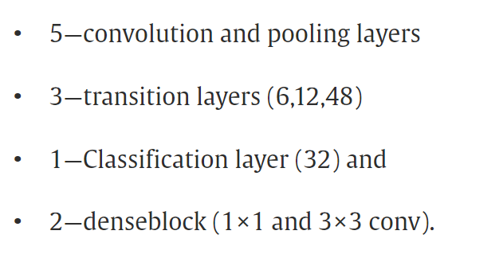
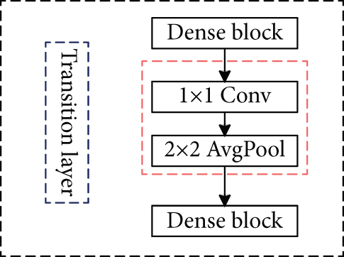
Model Development
Base Model:
The DenseNet-201 model was used
in this work as a base model.
INTRODUCTION
INTRODUCTION
PPT模板下载：www.1ppt.com/moban/ 行业PPT模板：www.1ppt.com/hangye/
节日PPT模板：www.1ppt.com/jieri/ PPT素材下载：www.1ppt.com/sucai/
PPT背景图片：www.1ppt.com/beijing/ PPT图表下载：www.1ppt.com/tubiao/
优秀PPT下载：www.1ppt.com/xiazai/ PPT教程： www.1ppt.com/powerpoint/
Word教程： www.1ppt.com/word/ Excel教程：www.1ppt.com/excel/
资料下载：www.1ppt.com/ziliao/ PPT课件下载：www.1ppt.com/kejian/
范文下载：www.1ppt.com/fanwen/ 试卷下载：www.1ppt.com/shiti/
教案下载：www.1ppt.com/jiaoan/ PPT论坛：www.1ppt.cn
PPT模板下载：www.1ppt.com/moban/ 行业PPT模板：www.1ppt.com/hangye/
节日PPT模板：www.1ppt.com/jieri/ PPT素材下载：www.1ppt.com/sucai/
PPT背景图片：www.1ppt.com/beijing/ PPT图表下载：www.1ppt.com/tubiao/
优秀PPT下载：www.1ppt.com/xiazai/ PPT教程： www.1ppt.com/powerpoint/
Word教程： www.1ppt.com/word/ Excel教程：www.1ppt.com/excel/
资料下载：www.1ppt.com/ziliao/ PPT课件下载：www.1ppt.com/kejian/
范文下载：www.1ppt.com/fanwen/ 试卷下载：www.1ppt.com/shiti/
教案下载：www.1ppt.com/jiaoan/ PPT论坛：www.1ppt.cn
RESEARCH CHALLENGES & LIMITATIONS
DATA
COLLECTION
RESEARCH IDEAS & OBJECTIVES
METHODOLOGY
RESEARCH ARRANGEMENT
RESULTS AND DISCUSSION
未来工作
7

Slide 11
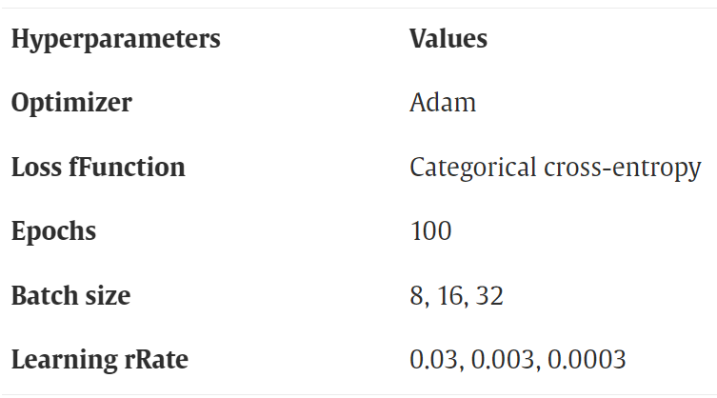
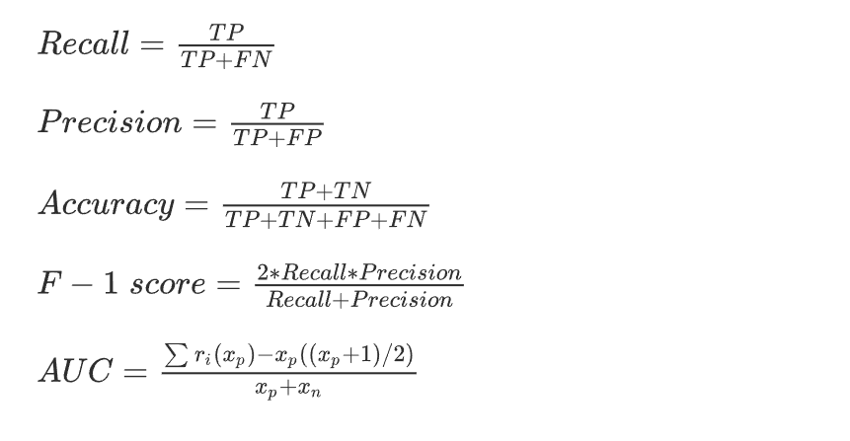
Model Development
Models hyper-parameters:
Evaluation metrics:
INTRODUCTION
INTRODUCTION
PPT模板下载：www.1ppt.com/moban/ 行业PPT模板：www.1ppt.com/hangye/
节日PPT模板：www.1ppt.com/jieri/ PPT素材下载：www.1ppt.com/sucai/
PPT背景图片：www.1ppt.com/beijing/ PPT图表下载：www.1ppt.com/tubiao/
优秀PPT下载：www.1ppt.com/xiazai/ PPT教程： www.1ppt.com/powerpoint/
Word教程： www.1ppt.com/word/ Excel教程：www.1ppt.com/excel/
资料下载：www.1ppt.com/ziliao/ PPT课件下载：www.1ppt.com/kejian/
范文下载：www.1ppt.com/fanwen/ 试卷下载：www.1ppt.com/shiti/
教案下载：www.1ppt.com/jiaoan/ PPT论坛：www.1ppt.cn
PPT模板下载：www.1ppt.com/moban/ 行业PPT模板：www.1ppt.com/hangye/
节日PPT模板：www.1ppt.com/jieri/ PPT素材下载：www.1ppt.com/sucai/
PPT背景图片：www.1ppt.com/beijing/ PPT图表下载：www.1ppt.com/tubiao/
优秀PPT下载：www.1ppt.com/xiazai/ PPT教程： www.1ppt.com/powerpoint/
Word教程： www.1ppt.com/word/ Excel教程：www.1ppt.com/excel/
资料下载：www.1ppt.com/ziliao/ PPT课件下载：www.1ppt.com/kejian/
范文下载：www.1ppt.com/fanwen/ 试卷下载：www.1ppt.com/shiti/
教案下载：www.1ppt.com/jiaoan/ PPT论坛：www.1ppt.cn
RESEARCH CHALLENGES & LIMITATIONS
DATA
COLLECTION
RESEARCH IDEAS & OBJECTIVES
METHODOLOGY
RESEARCH ARRANGEMENT
RESULTS AND DISCUSSION
未来工作
8

Slide 12
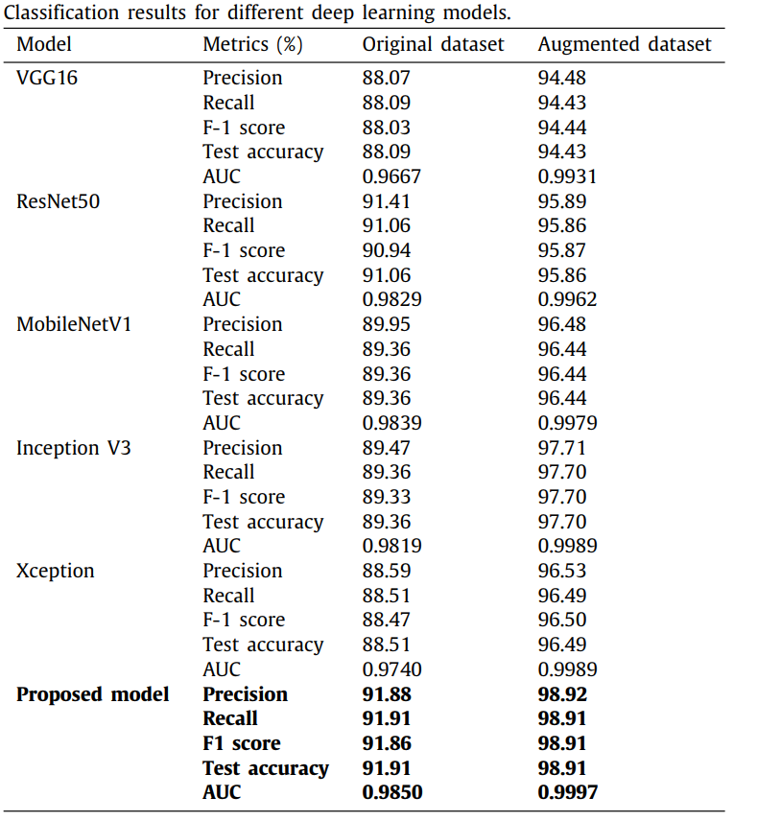
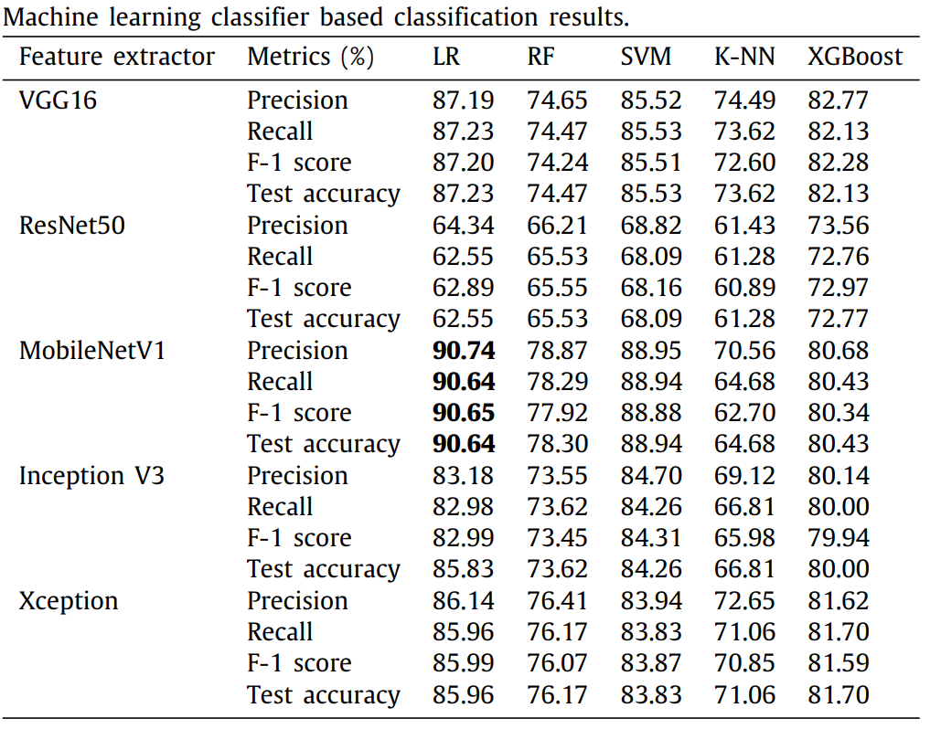
Results and discussion
INTRODUCTION
INTRODUCTION
PPT模板下载：www.1ppt.com/moban/ 行业PPT模板：www.1ppt.com/hangye/
节日PPT模板：www.1ppt.com/jieri/ PPT素材下载：www.1ppt.com/sucai/
PPT背景图片：www.1ppt.com/beijing/ PPT图表下载：www.1ppt.com/tubiao/
优秀PPT下载：www.1ppt.com/xiazai/ PPT教程： www.1ppt.com/powerpoint/
Word教程： www.1ppt.com/word/ Excel教程：www.1ppt.com/excel/
资料下载：www.1ppt.com/ziliao/ PPT课件下载：www.1ppt.com/kejian/
范文下载：www.1ppt.com/fanwen/ 试卷下载：www.1ppt.com/shiti/
教案下载：www.1ppt.com/jiaoan/ PPT论坛：www.1ppt.cn
PPT模板下载：www.1ppt.com/moban/ 行业PPT模板：www.1ppt.com/hangye/
节日PPT模板：www.1ppt.com/jieri/ PPT素材下载：www.1ppt.com/sucai/
PPT背景图片：www.1ppt.com/beijing/ PPT图表下载：www.1ppt.com/tubiao/
优秀PPT下载：www.1ppt.com/xiazai/ PPT教程： www.1ppt.com/powerpoint/
Word教程： www.1ppt.com/word/ Excel教程：www.1ppt.com/excel/
资料下载：www.1ppt.com/ziliao/ PPT课件下载：www.1ppt.com/kejian/
范文下载：www.1ppt.com/fanwen/ 试卷下载：www.1ppt.com/shiti/
教案下载：www.1ppt.com/jiaoan/ PPT论坛：www.1ppt.cn
RESEARCH CHALLENGES & LIMITATIONS
DATA
COLLECTION
RESEARCH IDEAS & OBJECTIVES
METHODOLOGY
RESEARCH ARRANGEMENT
RESULTS AND DISCUSSION
未来工作
9

Slide 13
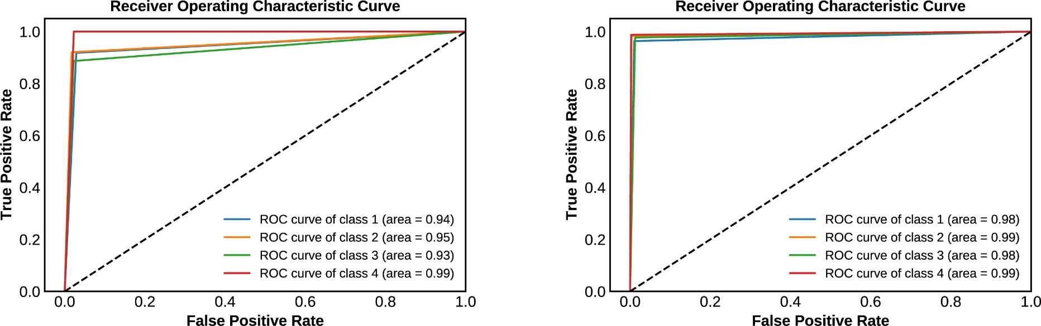
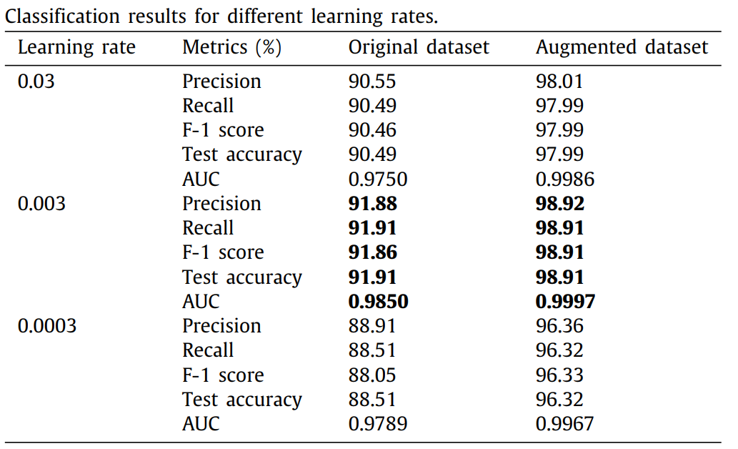
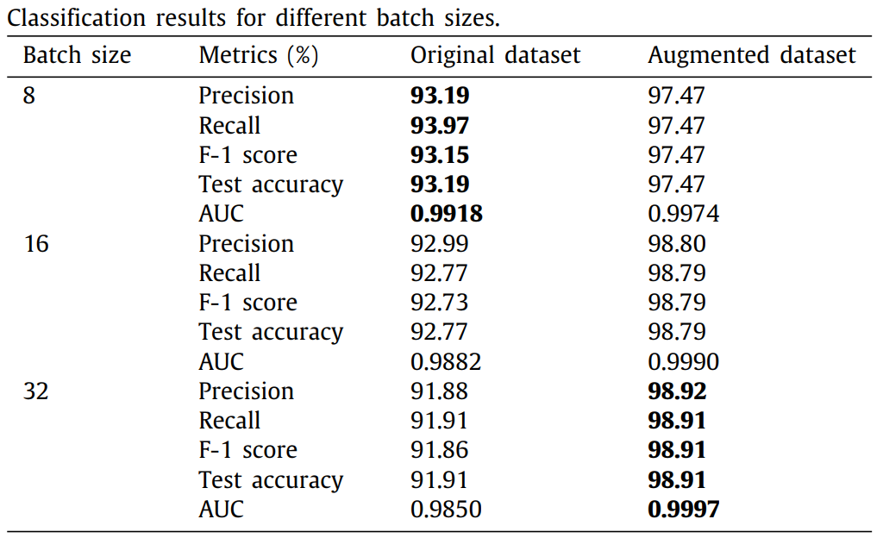
Results and discussion
ROC curve on original and augmented dataset
INTRODUCTION
INTRODUCTION
PPT模板下载：www.1ppt.com/moban/ 行业PPT模板：www.1ppt.com/hangye/
节日PPT模板：www.1ppt.com/jieri/ PPT素材下载：www.1ppt.com/sucai/
PPT背景图片：www.1ppt.com/beijing/ PPT图表下载：www.1ppt.com/tubiao/
优秀PPT下载：www.1ppt.com/xiazai/ PPT教程： www.1ppt.com/powerpoint/
Word教程： www.1ppt.com/word/ Excel教程：www.1ppt.com/excel/
资料下载：www.1ppt.com/ziliao/ PPT课件下载：www.1ppt.com/kejian/
范文下载：www.1ppt.com/fanwen/ 试卷下载：www.1ppt.com/shiti/
教案下载：www.1ppt.com/jiaoan/ PPT论坛：www.1ppt.cn
PPT模板下载：www.1ppt.com/moban/ 行业PPT模板：www.1ppt.com/hangye/
节日PPT模板：www.1ppt.com/jieri/ PPT素材下载：www.1ppt.com/sucai/
PPT背景图片：www.1ppt.com/beijing/ PPT图表下载：www.1ppt.com/tubiao/
优秀PPT下载：www.1ppt.com/xiazai/ PPT教程： www.1ppt.com/powerpoint/
Word教程： www.1ppt.com/word/ Excel教程：www.1ppt.com/excel/
资料下载：www.1ppt.com/ziliao/ PPT课件下载：www.1ppt.com/kejian/
范文下载：www.1ppt.com/fanwen/ 试卷下载：www.1ppt.com/shiti/
教案下载：www.1ppt.com/jiaoan/ PPT论坛：www.1ppt.cn
RESEARCH CHALLENGES & LIMITATIONS
DATA
COLLECTION
RESEARCH IDEAS & OBJECTIVES
METHODOLOGY
RESEARCH ARRANGEMENT
RESULTS AND DISCUSSION
未来工作
10

Slide 14
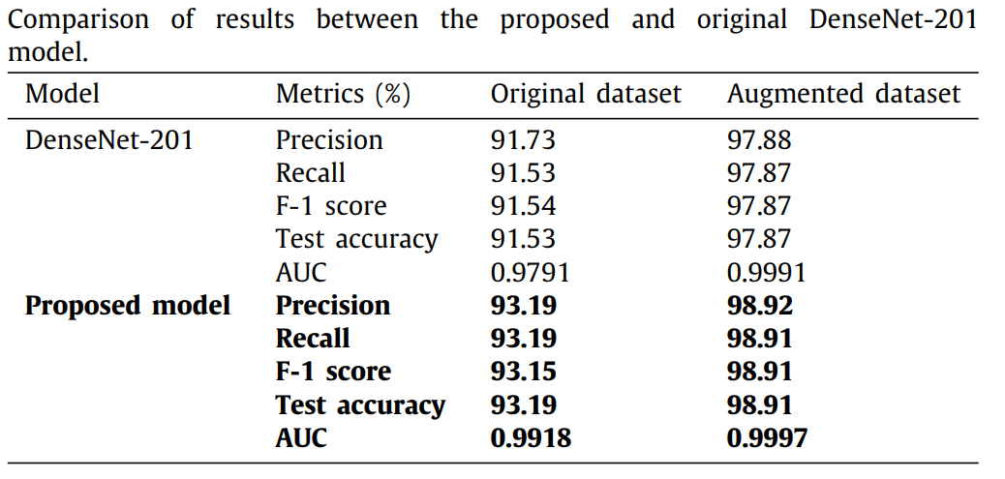
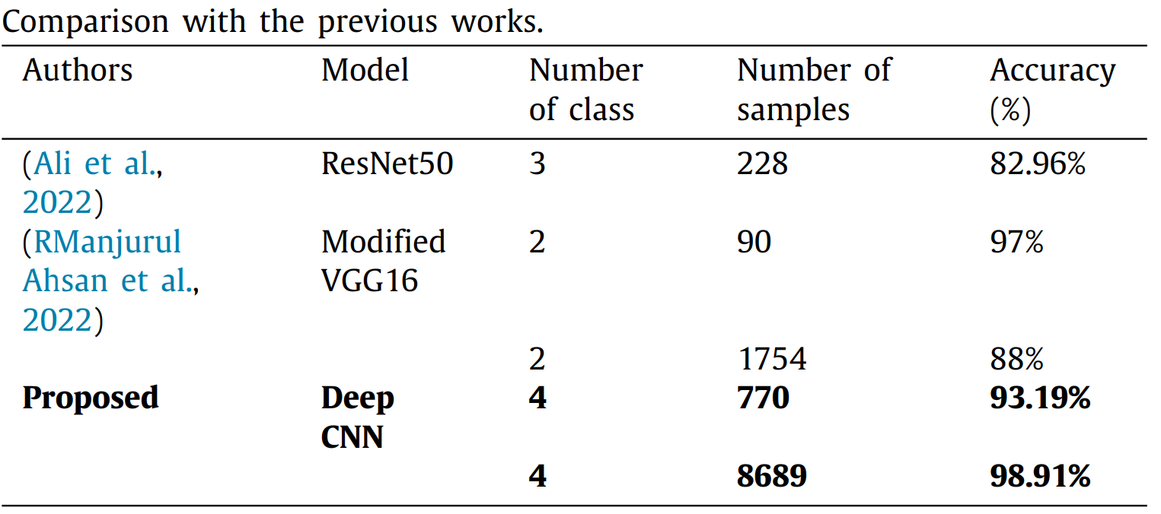
Results and discussion
Baseline VS Proposed Model Comparison
Comparison with SOTA
INTRODUCTION
INTRODUCTION
PPT模板下载：www.1ppt.com/moban/ 行业PPT模板：www.1ppt.com/hangye/
节日PPT模板：www.1ppt.com/jieri/ PPT素材下载：www.1ppt.com/sucai/
PPT背景图片：www.1ppt.com/beijing/ PPT图表下载：www.1ppt.com/tubiao/
优秀PPT下载：www.1ppt.com/xiazai/ PPT教程： www.1ppt.com/powerpoint/
Word教程： www.1ppt.com/word/ Excel教程：www.1ppt.com/excel/
资料下载：www.1ppt.com/ziliao/ PPT课件下载：www.1ppt.com/kejian/
范文下载：www.1ppt.com/fanwen/ 试卷下载：www.1ppt.com/shiti/
教案下载：www.1ppt.com/jiaoan/ PPT论坛：www.1ppt.cn
PPT模板下载：www.1ppt.com/moban/ 行业PPT模板：www.1ppt.com/hangye/
节日PPT模板：www.1ppt.com/jieri/ PPT素材下载：www.1ppt.com/sucai/
PPT背景图片：www.1ppt.com/beijing/ PPT图表下载：www.1ppt.com/tubiao/
优秀PPT下载：www.1ppt.com/xiazai/ PPT教程： www.1ppt.com/powerpoint/
Word教程： www.1ppt.com/word/ Excel教程：www.1ppt.com/excel/
资料下载：www.1ppt.com/ziliao/ PPT课件下载：www.1ppt.com/kejian/
范文下载：www.1ppt.com/fanwen/ 试卷下载：www.1ppt.com/shiti/
教案下载：www.1ppt.com/jiaoan/ PPT论坛：www.1ppt.cn
RESEARCH CHALLENGES & LIMITATIONS
DATA
COLLECTION
RESEARCH IDEAS & OBJECTIVES
METHODOLOGY
RESEARCH ARRANGEMENT
RESULTS AND DISCUSSION
未来工作
11

Slide 15
Conclusion
MSID database and MonkeyNet model improve early detection and classification of monkeypox.
Augmented dataset enhances MonkeyNet's classification accuracy to 98.91%.
Evaluation metrics validate the model's high precision, recall, F-1 score, and accuracy.
Deep learning and image-based technology show promise in real-world monkeypox detection and classification.
AI-driven approaches offer potential for improved disease surveillance and response strategies.
INTRODUCTION
INTRODUCTION
PPT模板下载：www.1ppt.com/moban/ 行业PPT模板：www.1ppt.com/hangye/
节日PPT模板：www.1ppt.com/jieri/ PPT素材下载：www.1ppt.com/sucai/
PPT背景图片：www.1ppt.com/beijing/ PPT图表下载：www.1ppt.com/tubiao/
优秀PPT下载：www.1ppt.com/xiazai/ PPT教程： www.1ppt.com/powerpoint/
Word教程： www.1ppt.com/word/ Excel教程：www.1ppt.com/excel/
资料下载：www.1ppt.com/ziliao/ PPT课件下载：www.1ppt.com/kejian/
范文下载：www.1ppt.com/fanwen/ 试卷下载：www.1ppt.com/shiti/
教案下载：www.1ppt.com/jiaoan/ PPT论坛：www.1ppt.cn
PPT模板下载：www.1ppt.com/moban/ 行业PPT模板：www.1ppt.com/hangye/
节日PPT模板：www.1ppt.com/jieri/ PPT素材下载：www.1ppt.com/sucai/
PPT背景图片：www.1ppt.com/beijing/ PPT图表下载：www.1ppt.com/tubiao/
优秀PPT下载：www.1ppt.com/xiazai/ PPT教程： www.1ppt.com/powerpoint/
Word教程： www.1ppt.com/word/ Excel教程：www.1ppt.com/excel/
资料下载：www.1ppt.com/ziliao/ PPT课件下载：www.1ppt.com/kejian/
范文下载：www.1ppt.com/fanwen/ 试卷下载：www.1ppt.com/shiti/
教案下载：www.1ppt.com/jiaoan/ PPT论坛：www.1ppt.cn
RESEARCH CHALLENGES & LIMITATIONS
DATA
COLLECTION
RESEARCH IDEAS & OBJECTIVES
METHODOLOGY
RESEARCH ARRANGEMENT
RESULTS AND DISCUSSION
未来工作
12

Slide 16
My Views on the Paper's Research Findings and Drawbacks
INTRODUCTION
INTRODUCTION
Dependency on pre-trained models: The utilization of pre-trained models, while convenient, may restrict the ability to fine-tune the network architecture specifically for monkeypox classification. This could potentially limit the model's performance optimization and customization for the specific task.
Lack of exploration of ensemble or hybrid learning: The study does not investigate the potential benefits of ensemble learning techniques or the combination of multiple models to enhance the accuracy and robustness of the monkeypox classification system.
Absence of optimization algorithms such as metaheuristics: The paper does not incorporate optimization algorithms like metaheuristics, which could potentially improve the training process and model convergence.
PPT模板下载：www.1ppt.com/moban/ 行业PPT模板：www.1ppt.com/hangye/
节日PPT模板：www.1ppt.com/jieri/ PPT素材下载：www.1ppt.com/sucai/
PPT背景图片：www.1ppt.com/beijing/ PPT图表下载：www.1ppt.com/tubiao/
优秀PPT下载：www.1ppt.com/xiazai/ PPT教程： www.1ppt.com/powerpoint/
Word教程： www.1ppt.com/word/ Excel教程：www.1ppt.com/excel/
资料下载：www.1ppt.com/ziliao/ PPT课件下载：www.1ppt.com/kejian/
范文下载：www.1ppt.com/fanwen/ 试卷下载：www.1ppt.com/shiti/
教案下载：www.1ppt.com/jiaoan/ PPT论坛：www.1ppt.cn
PPT模板下载：www.1ppt.com/moban/ 行业PPT模板：www.1ppt.com/hangye/
节日PPT模板：www.1ppt.com/jieri/ PPT素材下载：www.1ppt.com/sucai/
PPT背景图片：www.1ppt.com/beijing/ PPT图表下载：www.1ppt.com/tubiao/
优秀PPT下载：www.1ppt.com/xiazai/ PPT教程： www.1ppt.com/powerpoint/
Word教程： www.1ppt.com/word/ Excel教程：www.1ppt.com/excel/
资料下载：www.1ppt.com/ziliao/ PPT课件下载：www.1ppt.com/kejian/
范文下载：www.1ppt.com/fanwen/ 试卷下载：www.1ppt.com/shiti/
教案下载：www.1ppt.com/jiaoan/ PPT论坛：www.1ppt.cn
RESEARCH CHALLENGES & LIMITATIONS
DATA
COLLECTION
RESEARCH IDEAS & OBJECTIVES
METHODOLOGY
RESEARCH ARRANGEMENT
RESULTS AND DISCUSSION
未来工作
13

Slide 17
Thank you for your attention

